Slide 1
Liberty Central Schools
Smart School Plan 2026

Slide 2
High Tech Security
Today’s environment isn’t meeting expectations
Issues
01
02
03
04
Service Delays
Aging Infrastructure
Growth Limitations
Safety Concerns
Extended service lead times (2–3 weeks)
Aging and unreliable hardware
Limited scalability and flexibility
Service responsiveness impacting operations & safety

Slide 3
Our
Advancing reliability through intelligent reuse of existing systems
Proposal
Reuse Existing
Strengthen Reliability
Service Response
Scalability
Mercury Access control boards
Existing camera infrastructure
Existing wireless lock investments where practical
Existing district infrastructure
Address wireless lock communication issues
Improve access control reliability
Upgrade aging video infrastructure
Add IRP / lockdown capabilities
Prepare for the Future
Future door additions
Unified video + access platform
Long-term support and serviceability

Slide 4
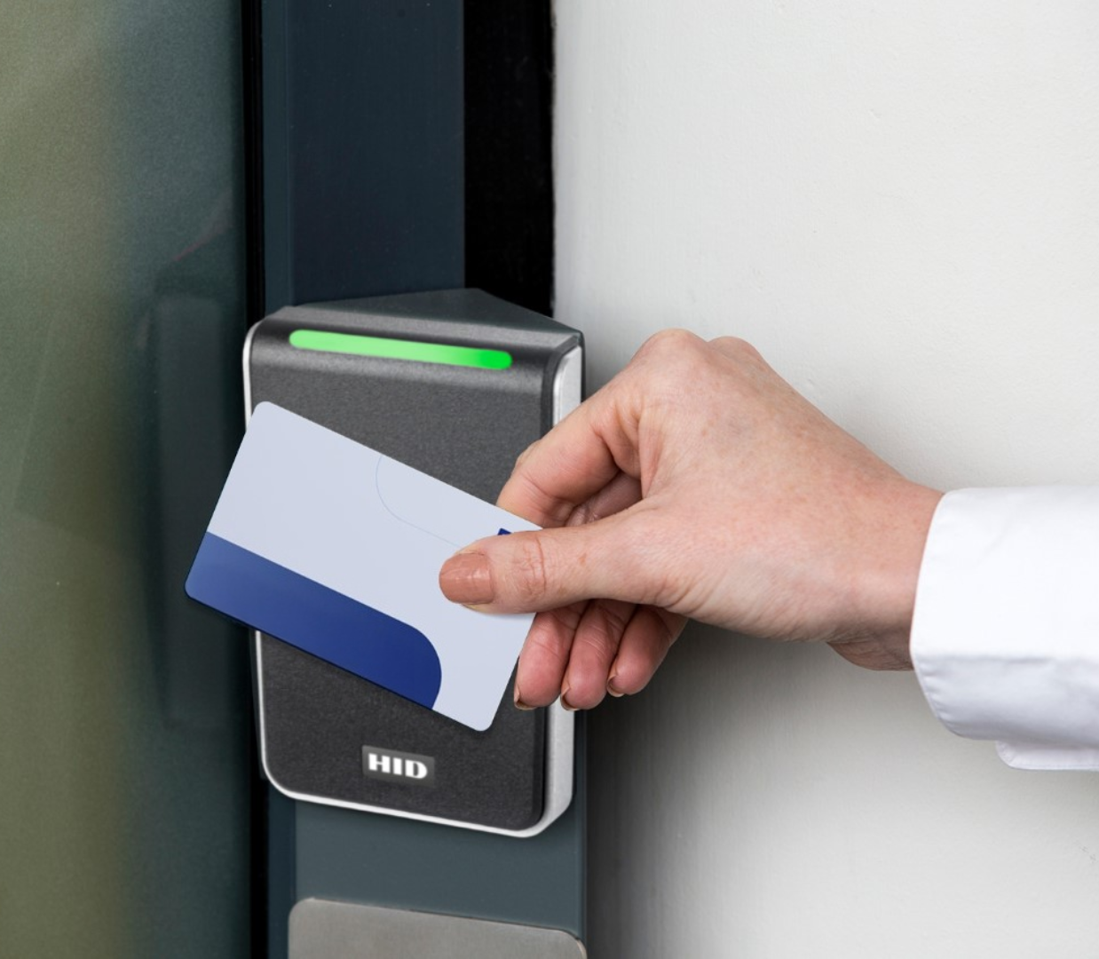
Access Control
Conversion
Smarter Access Without Rip-and-Replace
Reusing existing Mercury boards
Leveraging existing wiring and infrastructure
System Enhancements
Upgrading system intelligence and usability
Strengthening reliability and control across all facilities
Key Outcomes
Faster deployment
Reduced disruption
Improved system stability

Slide 5
What Liberty
CSD Gains
Better
Reliability
Better
Visibility
Better Lockdown Integration
Better Management Tools
Faster Issue Resolution
Foundation for Future Expansion

Slide 6
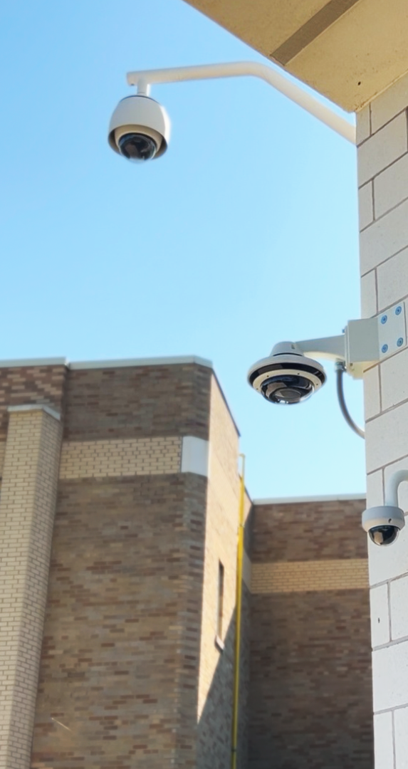
Video System
Upgrade
Reuse Existing Assets
Performance
Reduce costs and maximize current investments
Replacing aging and underperforming servers
Image
Modernization
Reliability
Scalable
This initiative upgrades backend infrastructure to improve performance, reliability, and storage stability, while protecting existing investments. It also creates a scalable foundation for future camera expansion.
Better system performance and storage reliability
Positioning for future expansion

Slide 7
What Liberty
CSD Gains
Protect Existing Investments
Upgrade the backend Infrastructure
Improve Performance
Improve
Reliability
Increase Storage Stability
Foundation for Future Expansion

Slide 8
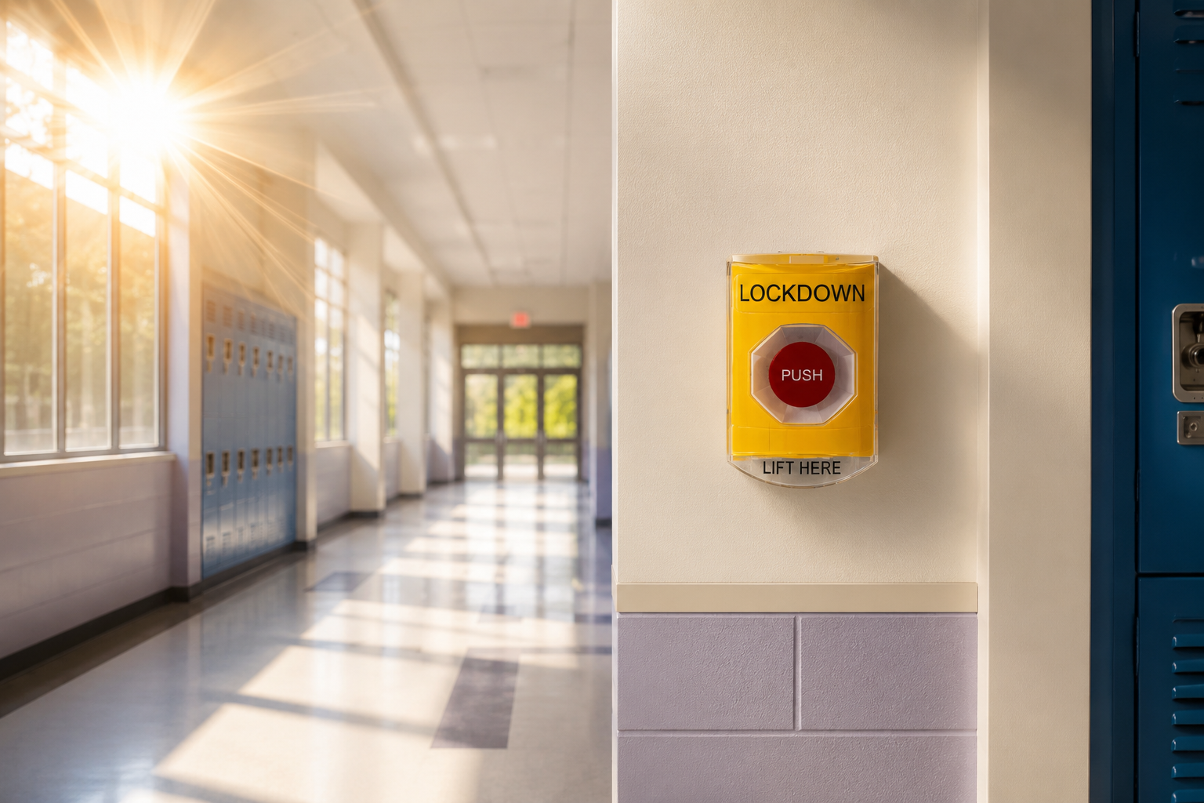
Lockdown
Image
Upgrade
Delivers a streamlined, facility-wide lockdown approach that improves speed, consistency, and strengthens reliability.
01
02
03
Simple
Reliable
Best Practices
Engineered for high-stress use when fine motor skills decline.
The hardwired buttons are continuously monitored
The Incident Response Panel (IRP) reflects years of K-12 best practices.

Slide 9
What Liberty
CSD Gains
Faster Emergency Response
Simple
Lockdown
Improve
Reliability
Improve Student and Staff Safety
Reduce Human Error

Slide 10
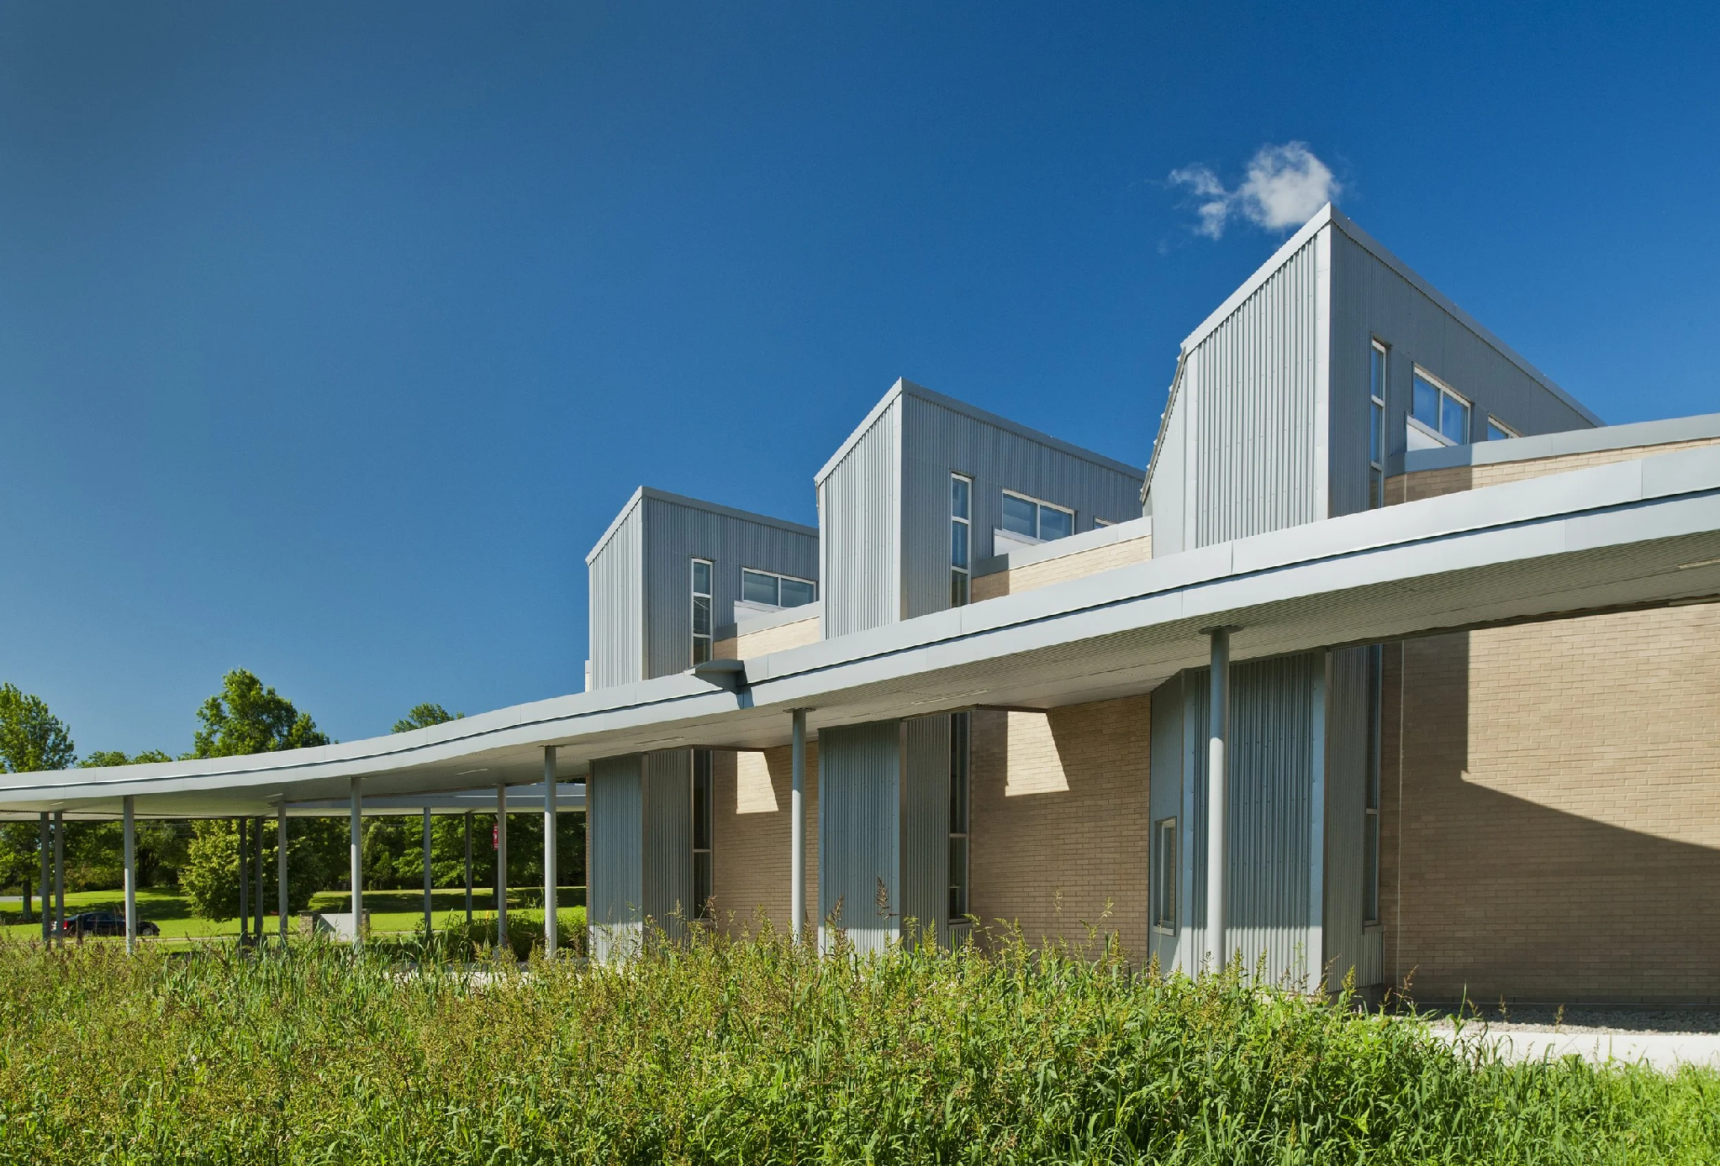
What This Means
For Liberty CSD
Short-Term
Long-Term
Maximize existing system investments
Strengthen current infrastructure
Improve reliability across platforms
Scalable foundation for future growth
Adaptability as needs evolve
Enhanced serviceability and support
Future-Proofing Your District

Slide 11
Smart Bond Pricing Detail
The SMART Schools Bond Act allows districts to complete eligible security projects upfront, with the State reimbursing 100% of approved project costs through bond funds.
Video Upgrade
$123,718.62
Access Control
Upgrade
$588,468.41
Automated Lockdown
Upgrade
$106,412.44

Slide 12
Now what ??
Planning Committee
Please send any questions or comments to:
PSULLIVAN@libertyk12.org
Has Reviewed this proposal and recommends it to the Board of Education
t
Future-Proofing Your District

